Slide 1

History and schools of Psychology UAPY102
Bachelor of Science in Psychology
Lecture: Deshani Wimalasiri
BA (Hon) in Psychology
University of Peradeniya

Slide 2
Learning Outcomes
Trace the historical development of psychology.
Explain the philosophical influences on major psychological theories.
Distinguish among the key schools of thought and their methodologies.
Evaluate alternative and pluralistic perspectives of history in psychology.
Recognize underrepresented contributions (e.g., women and minority psychologists).
Apply historical insights to critique modern psychological theories and research.

Slide 3
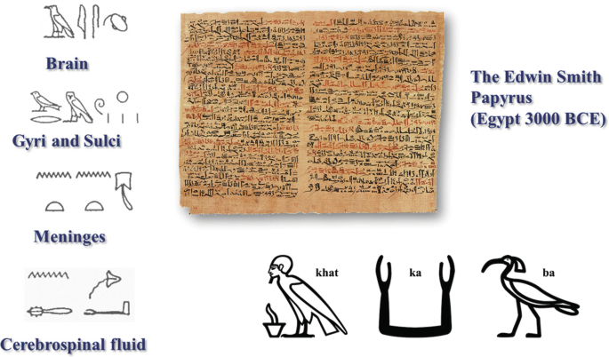
Timeline of Psychology
People from many different cultures have thought about what the mind, soul, spirit, heart, and brain really are.
In Ancient Egypt, the Edwin Smith Papyrus is one of the first documents to describe the brain and suggest what it might do, especially in medicine and surgery.

Slide 4
Greek thinkers, starting with Thales around 550 BC and continuing into Roman times, developed ideas about the "psyche" (which means mind or soul and is where the word "psychology" comes from) and other important ideas like intellect, emotions, and reasoning.

Slide 5
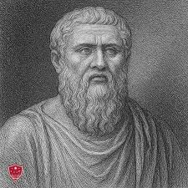
The most famous philosophers in this area are Plato, Pythagoras, and Aristotle. Plato, especially in his work "Republic," explained the soul as having three parts, told the story of the Chariot Allegory, and talked about love (eros).
These ideas influenced Western philosophy a lot. Aristotle’s work "De Anima" (About the Soul) also helped explain what is the soul.

Slide 6
China had a long history of administering tests of ability part of its education system.
In the 6th century AD, Lin Xie carried out an early experiment, in which he asked people to draw a square with one hand and at the same time draw a circle with the other (ostensibly to test people's vulnerability to distraction).
Some have claimed that this is the first psychology experiment, and, therefore, the beginnings of psychology as an experimental science.

Slide 7
India, had an elaborate theory of "the self" in its Vedanta philosophical writings.
Buddhist philosophies have developed several psychological theories formulating interpretations of the mind and concepts such as aggregates (skandhas), emptiness (sunyata), non-self (anatta), mindfulness and Buddha-nature, which are addressed today by theorists of humanistic and transpersonal Psychology.
Several Buddhist lineages have developed notions analogous to those of modern Western psychology, such as the unconscious, personal development and character improvement.

Slide 8
Renaissance & Early Modern Philosophy (1500 – 1700s)
Humanism and scientific thinking begin.
René Descartes (1596–1650): Mind-body dualism
John Locke (1632–1704): Mind is a blank slate tabula rasa; experience shapes knowledge.
David Hume (1711–1776): Emotions and human nature influence behaviour.

Slide 9
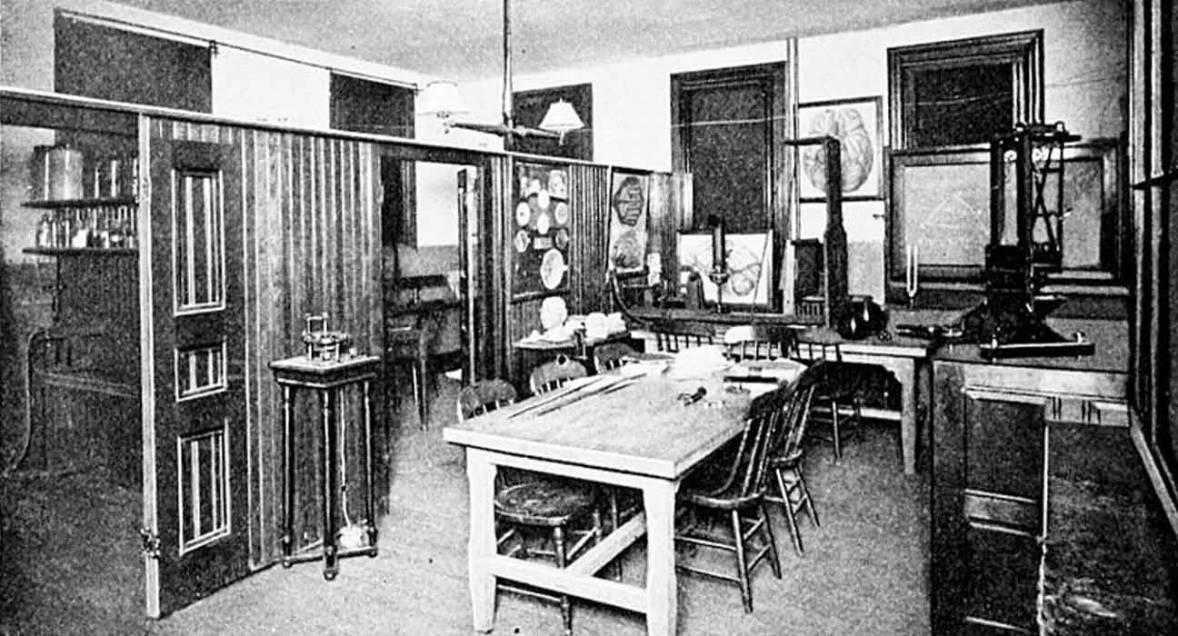
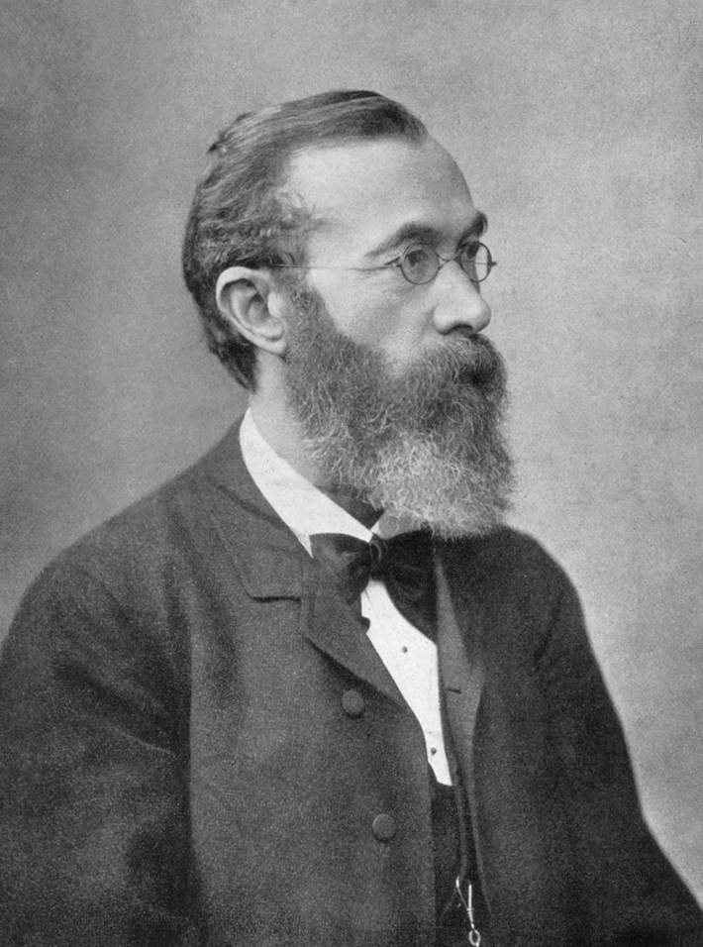
Foundations of Scientific Psychology (18th – 19th Century)
Observation, experimentation, and measurement.
Wilhelm Wundt (1879) → established first
psychology lab in Leipzig, German
Late 19th century → Psychology becomes a scientific discipline
Focus on measurement, observation, and experiment
Studied the structure of consciousness through introspection

Slide 10
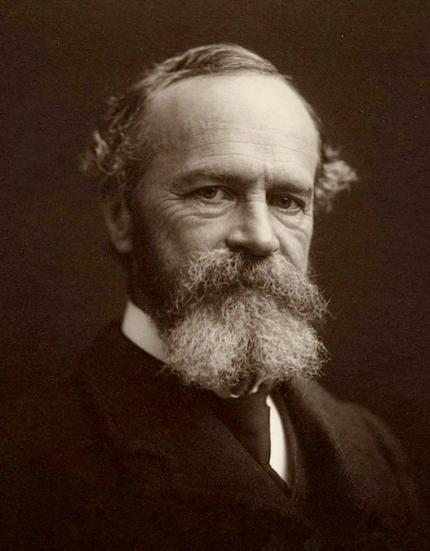
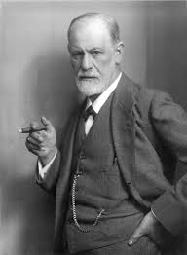
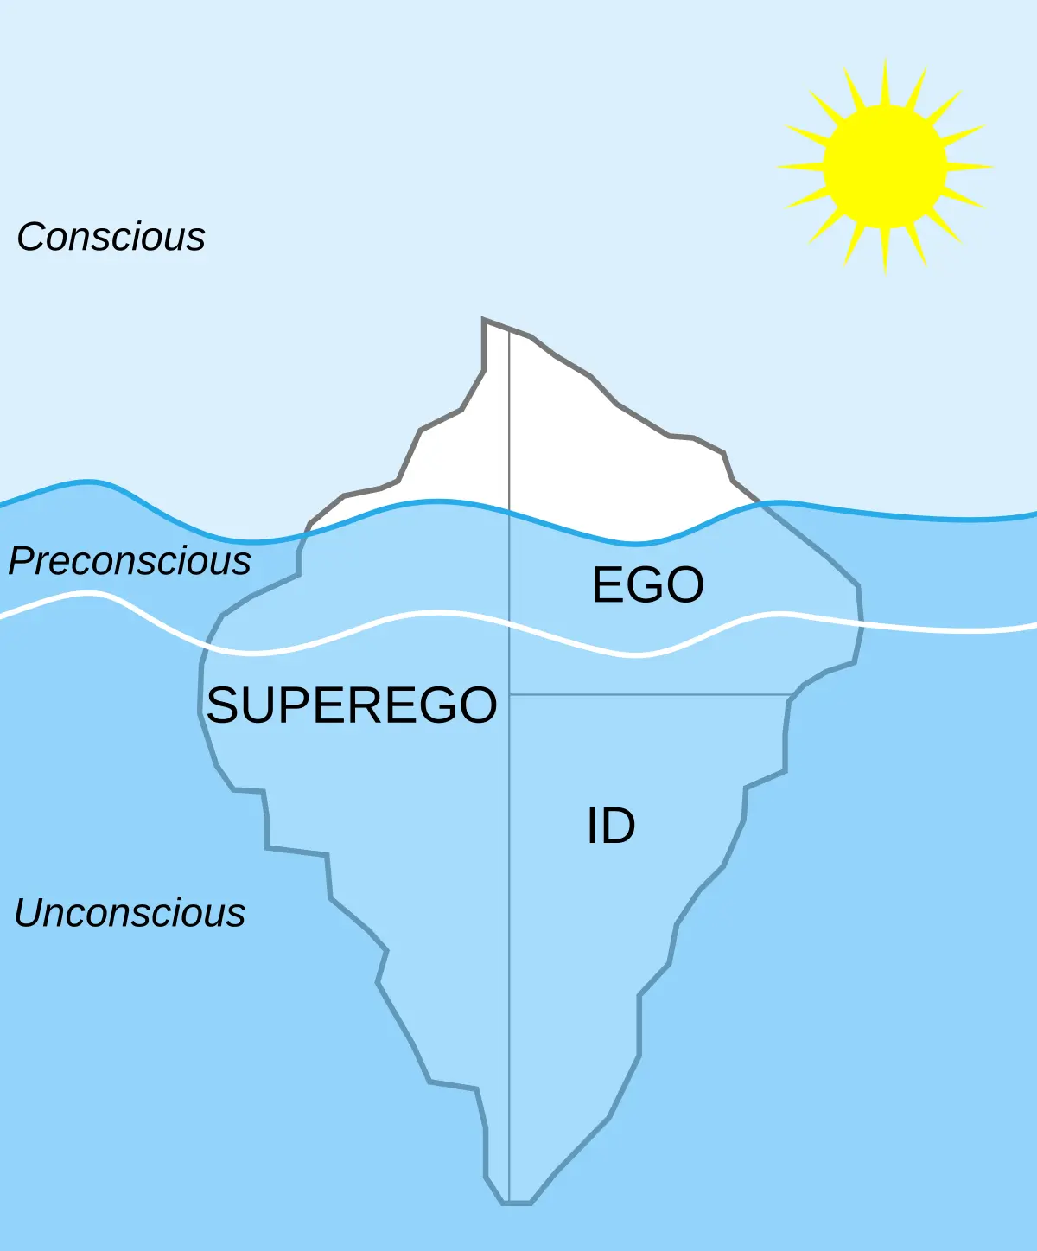
William James (1842–1910): Functionalism; mind helps adapt to environment.
Sigmund Freud (1856–1939): Psychoanalysis; unconscious mind and childhood influence behavior.

Slide 11
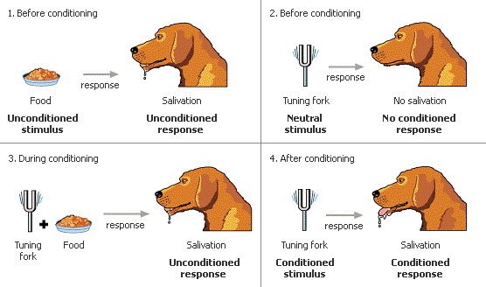
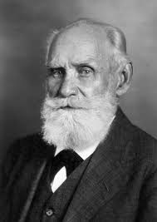
Ivan Pavlov (1849–1936): Classical conditioning; environment shapes behavior.
.

Slide 12
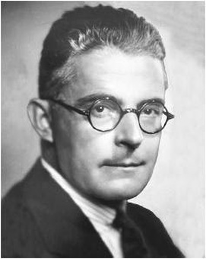
John B. Watson (1878–1958): Behaviorism; focus on observable behavior
Edward Titchener (1867–1927): Structuralism; mind’s elements studied via introspection.

Slide 13
Philosophical Roots
 | Description | Influence on Psychology
Empiricism (Locke) | Knowledge from experience | Led to Behaviorism, Experimental methods
Rationalism (Descartes) | Knowledge from reason | Linked to Cognitive Psychology
Dualism (Descartes) | Mind & body are separate | Inspired Mind-body debate
Materialism | Everything explained by physical processes | Supported Biological Psychology

Slide 14
Major Schools
Structuralism
Functionalism
Gestalt Psychology
Behaviourism
Psychoanalysis
Humanistic Psychology
Cognitivism
Biopsychology

Slide 15
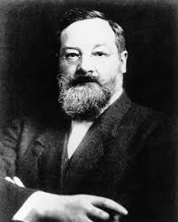
1. Structuralism
Structuralism is considered to be the first school of thought in psychology.
This theory was introduced by Edward Bradford Titchener, who was a student of Wilhelm Wundt.
He introduced this theory to identify and study the structure of the human mind.
Stimulus error

Slide 16
Through the process called introspection, he studied these basic elements of consciousness.
Three parts of consciousness
Sensation
Image
Affective state

Slide 17
Criticisms
Use of Introspection – The way of describing what is felt differs from person to person.
Language – According to them, the problem arises as to what language should be used to describe objects in everyday life.
Since it is difficult to break experiences into separate parts, it is believed that things should be studied as a whole.
It was said that psychology exists only for the purpose of study.

Slide 18
Functionalism
Founded by William James and John Dewey (late 19th century).
Reaction against Structuralism , instead of “what the mind is,” focused on what the mind does.
The mind helps people adapt to their environment. Influenced by Darwin’s theory of evolution ,behavior has a purpose for survival.

Slide 19
William James:
Wrote “Principles of Psychology” (1890).
Introduced idea of “stream of consciousness.”
Believed mental processes are continuous and adaptive.

Slide 20
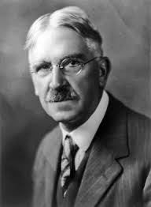
John Dewey:
Focused on learning and education.
Proposed the “reflex arc concept” , mind and behavior work as a whole system.
Saw thinking as a tool for problem-solving.

Slide 21
Criticisms
Lack of Specificity: : It doesn’t clearly explain how the mind works in detail.
Overemphasis on Adaptation: Pays too much attention to adaptation and ignores other influences.
Overlooking Complexity: Overlooks the complex inner workings of the mind.
Limited Scope: Can’t explain behaviours that don’t seem useful for survival.

