Slide 1
Major Schools
Structuralism
Functionalism
Gestalt Psychology
Behaviourism
Psychoanalysis
Humanistic Psychology
Cognitivism
Biopsychology

Slide 2
3.Gestalt Psychology
The term Gestalt is German and loosely means “configuration” or “structure”
Gestalt psychology is a school of thought that seeks to understand how the human brain perceives experiences, in particular, how we perceive structures as wholes, not just as sums of parts.

Slide 3
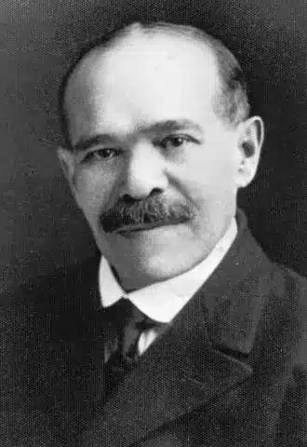
Key Figures in Gestalt Psychology
Max Wertheimer
Published “Experimental Studies of the Perception of Movement” in 1912; introduced the idea of apparent motion

Slide 4
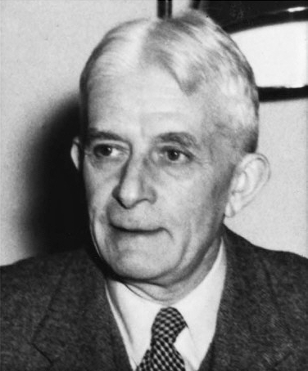
Wolfgang Köhler:
Introduced concept of psychophysical isomorphism; idea that perception is influenced by the state of the brain and tends toward a minimal energy state

Slide 5
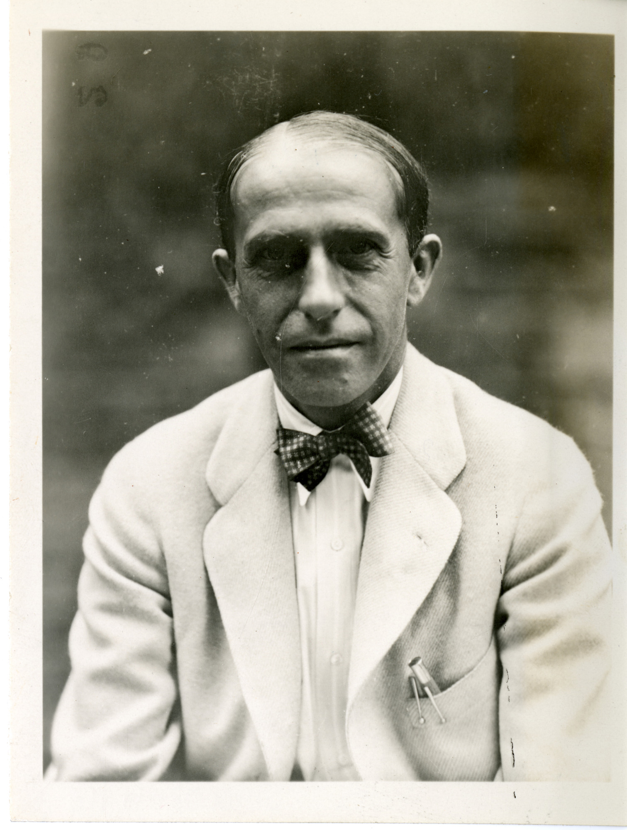
Kurt Koffka:
Expanded Gestalt ideas beyond visual perception into motor action, learning, memory, personality; helped bring Gestalt theory to the USA

Slide 6
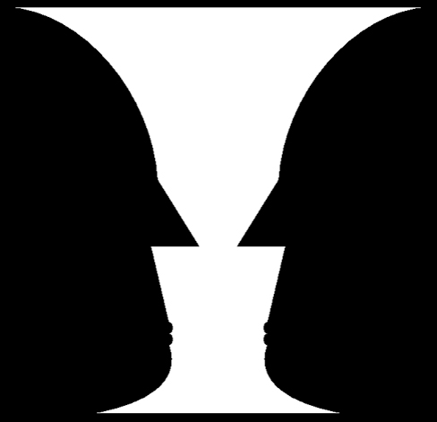
The Major Principles (Laws) of Gestalt Psychology
Figure-ground relationship
Elements are perceived as either figures (distinct elements of focus) or ground (background)

Slide 7
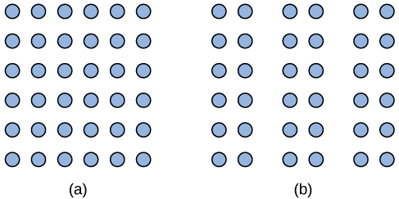
2. Proximity
Items located near each other are perceived as a group

Slide 8
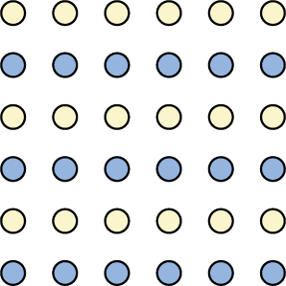
3. Similarity
Items similar in color, shape, orientation, size tend to be grouped.

Slide 9

4. law of continuity (or good continuation) and closure
suggests that we are more likely to perceive continuous, smooth flowing lines rather than jagged, broken lines. The principle of closure states that we organize our perceptions into complete objects rather than as a series of parts.

Slide 10
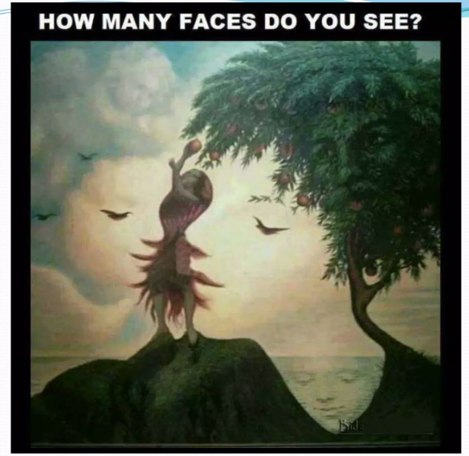


Slide 11
Applications of Gestalt Psychology
In design – advertising, web pages, packaging
In everyday perception
In psychology and counselling

Slide 12
Criticisms
The Gestalt school largely faded by the 1940s. Two main reasons: After moving from Germany, the key figures couldn't train many PhDs; and new empirical findings (especially in neuroscience/cognitive science) challenged some of Gestalt’s assumptions.
Nonetheless, many foundational questions about perception and awareness addressed by Gestalt theory continue to be relevant in modern psychology and neuroscience.

Slide 13
4.Behaviorism
Focuses on observable behaviour, not internal thoughts or feelings.
It believes behavior can be measured, trained, and changed.
Introduced by John B. Watson and developed further by B.F. Skinner.
Psychology should study behavior that can be observed and measured.
Learning occurs through conditioning.
Behavior is a result of stimulus → response connections.

Slide 14
John B. Watson (1878–1958)
Founder of Behaviorism.
Rejected introspection and focused only on what can be observed.
Famous Experiment: Little Albert (Fear conditioning).
Watson conditioned a baby to fear a white rat by pairing it with a loud noise.

Slide 15
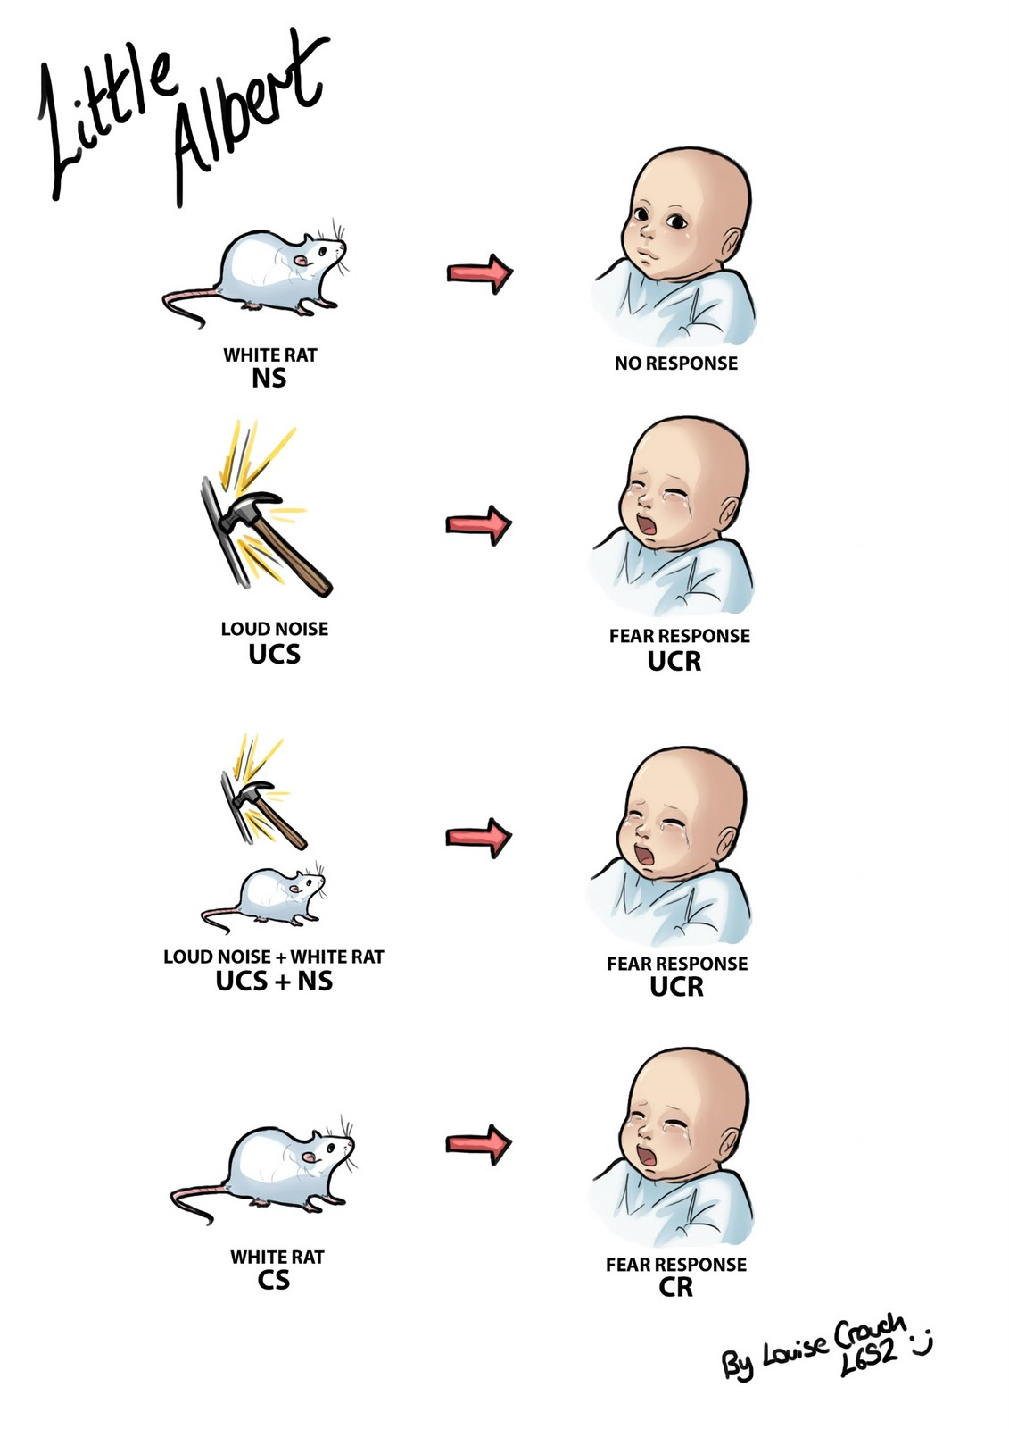

Slide 16
B.F. Skinner (1904–1990)
Expanded behaviorism with operant conditioning.
Believed behavior is shaped by rewards and punishments.
Developed the Skinner Box to study animal behavior.

Slide 17
Concept | Watson | Skinner
Focus | Classical Conditioning | Operant Conditioning
Main Idea | Behavior is learned through association | Behavior is shaped by rewards/punishments
Example | Little Albert Experiment | Skinner Box Experiment

Slide 18
Real-Life Applications
Used in education (reward-based learning)
Used in therapy (behavior modification)
Used in workplaces (incentives and motivation)
Used in animal training

Slide 19
5. Psychoanalysis
Developed by Sigmund Freud (1856–1939)
Focuses on unconscious mind
Explains personality development and mental disorders
Behavior influenced by hidden desires, fears, and memories

Slide 20
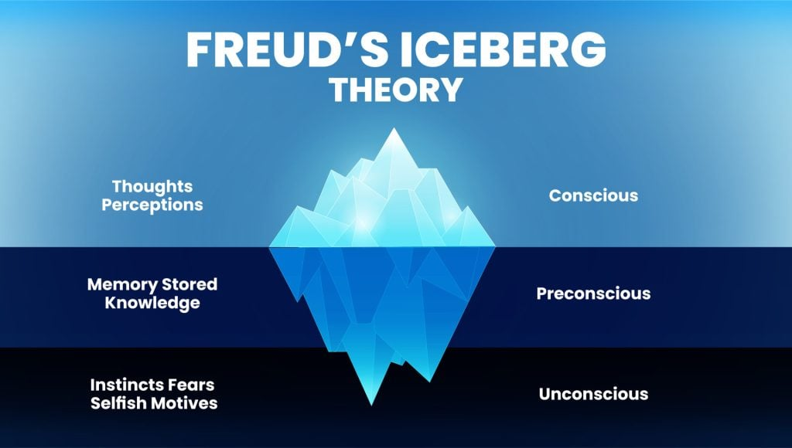
Structure of the Mind (Freud’s Iceberg Model)

Slide 21
Structure of Personality
Id – pleasure principle; instincts and desires (“I want it now!”)
Ego – reality principle; balance between id and reality
Superego – morality; right and wrong (conscience)
Example: If a person wants to eat cake while dieting:
Id says “Eat it!”
Superego says “No, it’s wrong.”
Ego says “Maybe just one small piece.”

Slide 22
Stages of Psychosexual Development
1.Oral stage (0–1 yr) – pleasure from mouth
2.Anal stage (1–3 yrs) – control and toilet training
3.Phallic stage (3–6 yrs) – focus on genitals
Oedipus
Electra
4.Latency stage (6–12 yrs) – learning and social skills
5.Genital stage (12+ yrs) – mature sexual interests

Slide 23
Défense Mechanisms
Unconscious strategies to protect the mind from anxiety
Common types:
Repression
Projection
Displacement
Denial
Reaction Formation
Rationalization
Sublimation

Slide 24
Criticism
Lack of scientific data analysis methods
Subjective interpretations of patients’ expressions
Misunderstanding or overemphasis of main concepts
Negative view of women
Too much focus on the past and childhood

